Slide 1
Confirmatory Factor Analysis: Guidelines
PSY 6113 001 Psychological Measurement
Augustine Osman
Department of Psychology
UTSA
Copyright ©2022

Slide 2
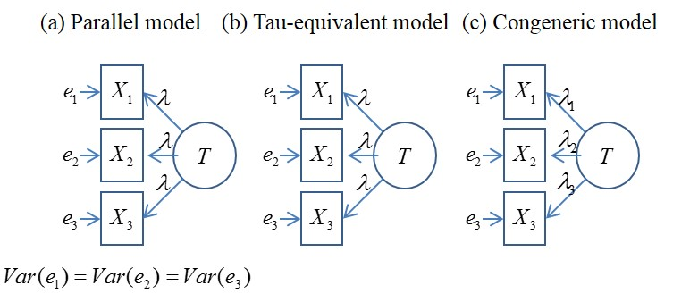
Review: Structural (covariance) Models
Unidimensional Models: Reflective

Slide 3
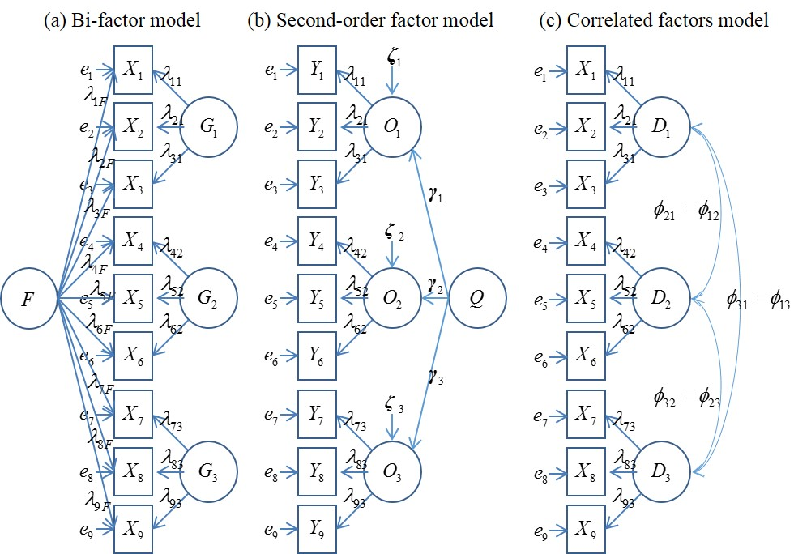
Multidimensional (covariance) Models-- Reflective

Slide 4
CFA: Some Advantages
Allows for specification of item-factor relationships [i.e., which items can load on a specific factor]: factor models.
Allows evaluating measurement error variances(e) for items and factors.

Slide 5
CFA: Some Advantages
Allows specifying if (a) factors are correlated and (b) measurement errors between pairs of variables can co-vary.
Helps provide empirical justification for the internal structure [validity] of an instrument.

Slide 6
CFA: Some Advantages
5. Allows for computing estimates of internal consistency for complex models.
>e.g., coefficient OmegaH (proportion of variance in the total score attributable to the general factor), within bifactor models.

Slide 7
Steps in the Modeling Process
1. Review all previous EFA structures that have been reported for the instrument [including a brief discussion of how the instrument was constructed].
Review the conceptual /theoretical foundation(s)
for the instrument and its related dimensions. [i.e., justification for construction and use—research /clinical].

Slide 8
Steps in the Modeling Process
3. For each model (e.g., unidimensional) develop a related figure [including all the parameters: fixed, free, or constrained].
Develop Tables [see APA] for reporting:
the distributional properties: items, scales
the parameter estimates [unstandardized, standardized] and the standard errors [SEs].
the specific fit indices [to be discussed].

Slide 9
Steps in the Modeling Process
4. Evaluate the (a) distributional properties of the items and (b) the response options to identify the appropriate estimator. Hint: assumption of non-normality [non-clinical data] might be instructive.
5. Evaluate estimates of internal consistency reliability for the dimension(s) of each instrument:
Options: Coefficient omega; Coefficient rho

Slide 10
Steps in the Modeling Process
Let us use JASP for the CFA Modeling, paying careful attention to the:
> Model fit Indices [Chi-square, df, p = ns]
> Other appropriate fit indices: Comparative fit index, information, etc.
> Recommended cut-off indices for model evaluation.

Slide 11
Steps in the Modeling Process
Measures of global fit:
The root-mean-square error of approximation (RMSEA) and associated confidence bounds:
> evaluates how closely the proposed model relates to a solution with perfect fit.
RMSEA ≤ .05 [Close fit],
RMSEA ≤ .06 [excellent],
RMSEA ≤ .08 [adequate fit]

Slide 12
Steps in the Modeling Process
The standardized root-mean-square residual (SRMR).
>evaluates the difference between the observed- and the model-predicted correlations.
>correlations, with smaller scores indicating better representation of the observed data.
SRMR <.10 [acceptable fit]
SRMR ≤ .08 [excellent fit]

Slide 13
Steps in the Modeling Process
The comparative fit index (CFI), and Tucker-Lewis Index (TLI).
>The CFI and TLI are incremental fit indices that compare the proposed model to a null solution
specifying zero correlations across items.
>Values of .90 and .95 are interpreted as evidence of
adequate and close fit.

